Slide 1
DATA ANALYTICS & MACHINE LEARNING
Dr. Emmanuel S. Pilli
Malaviya NIT Jaipur

Slide 2
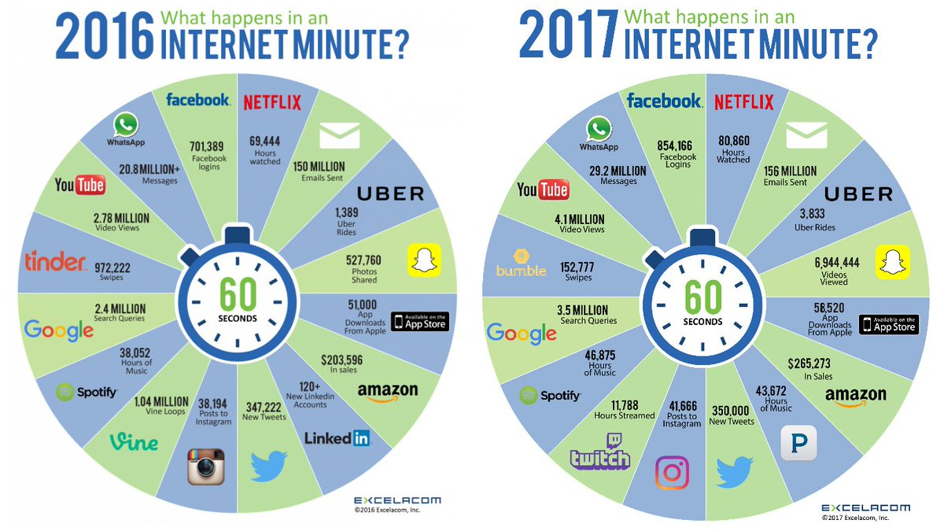
Data

Slide 3
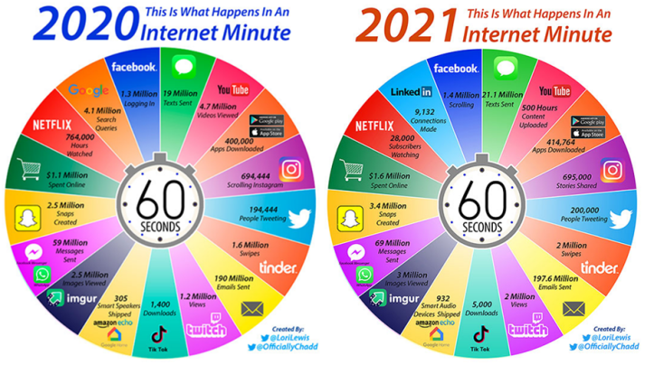
Data 2020 – 2021

Slide 4
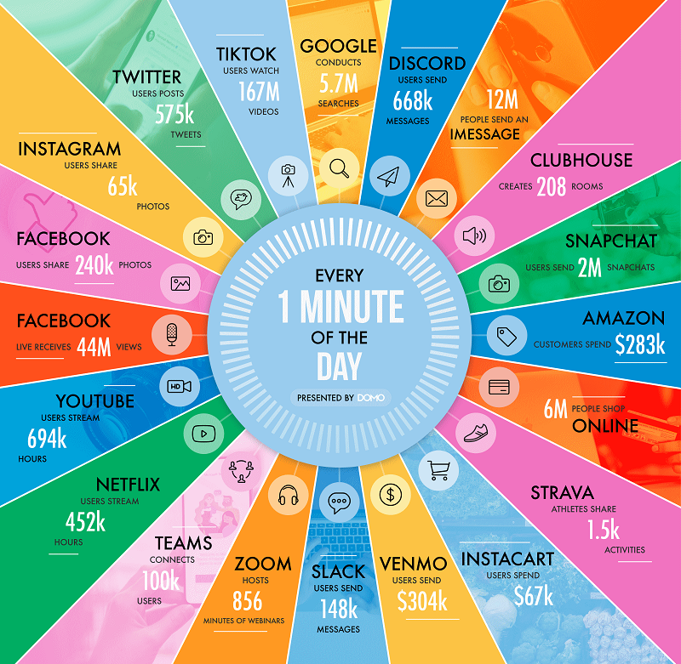
Data 2021

Slide 5
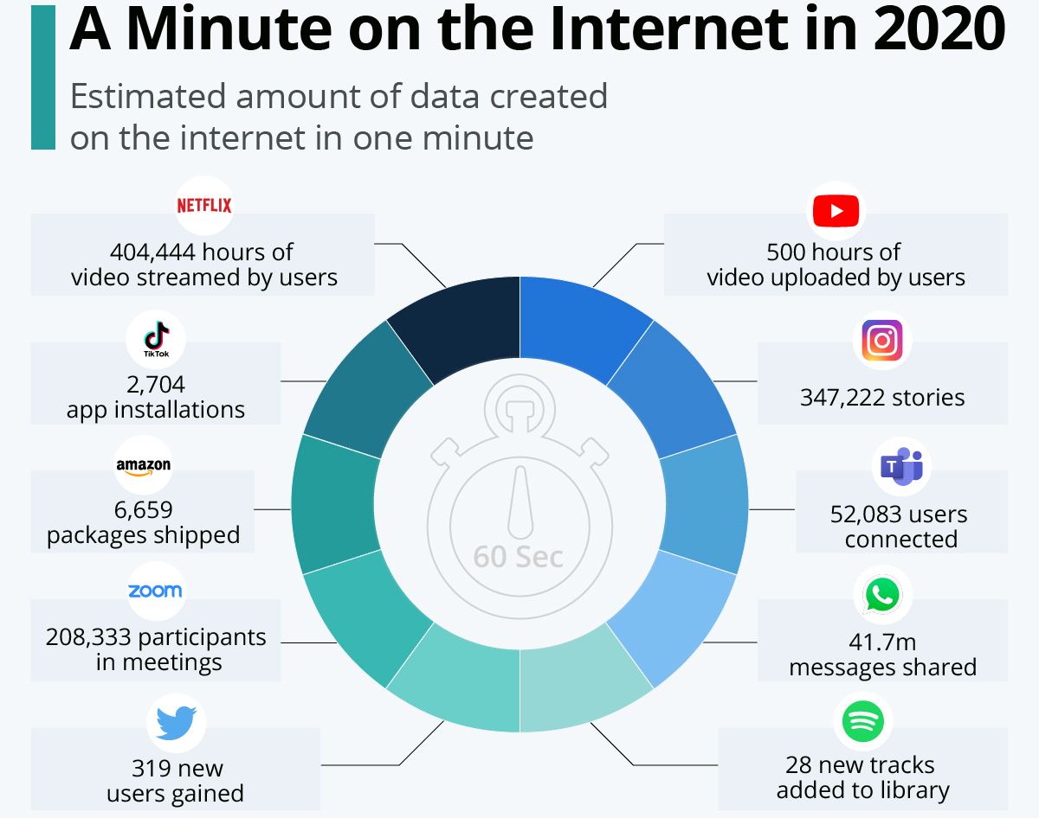
Data 2020

Slide 6
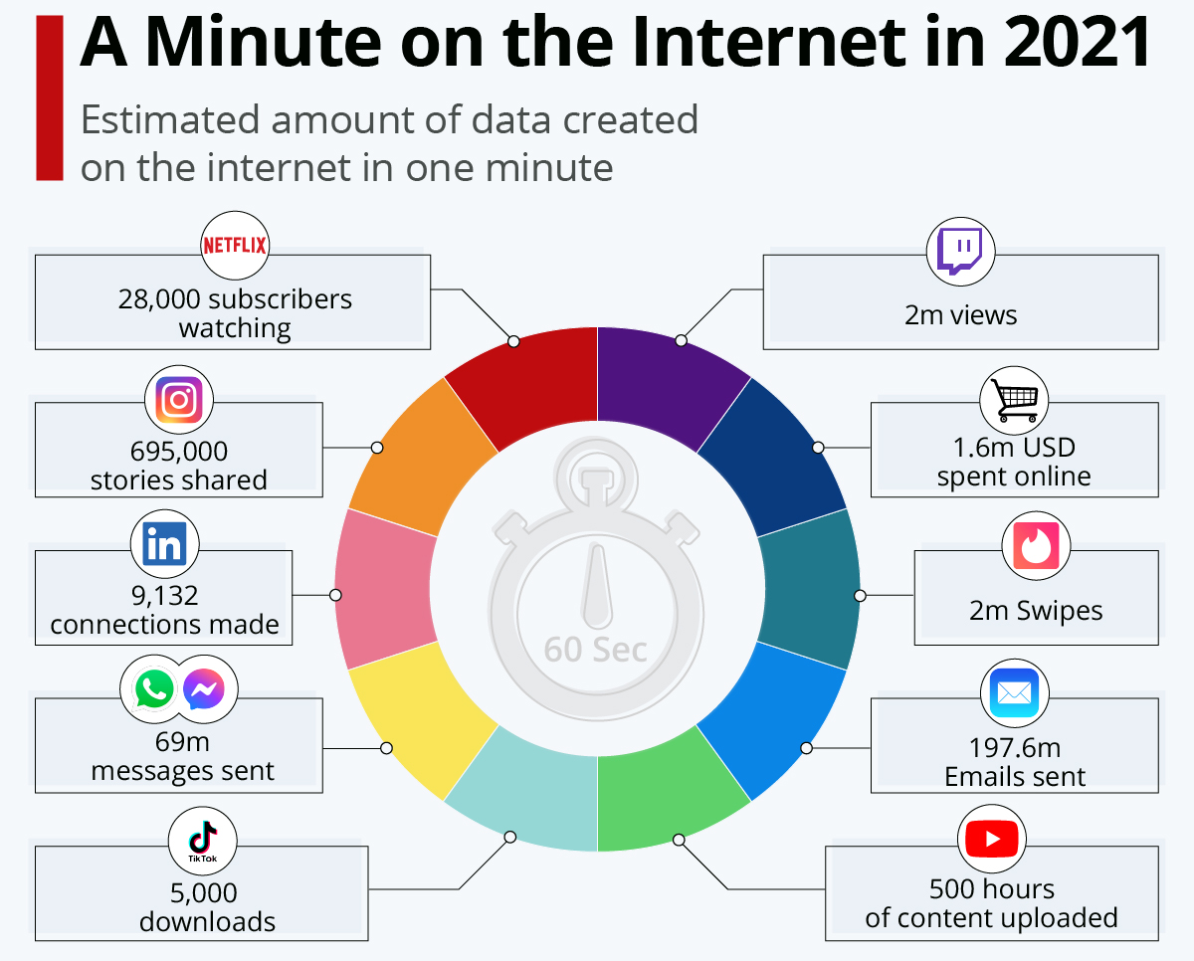
Data 2021

Slide 7
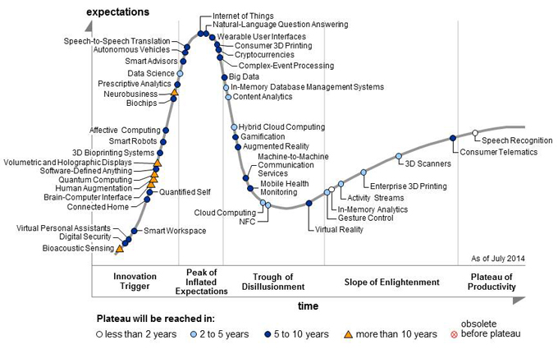
Gartner Hype Cycle 2014

Slide 8
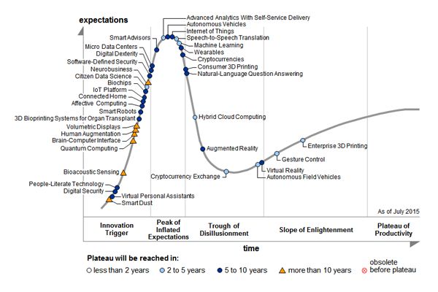
Gartner Hype Cycle 2015

Slide 9
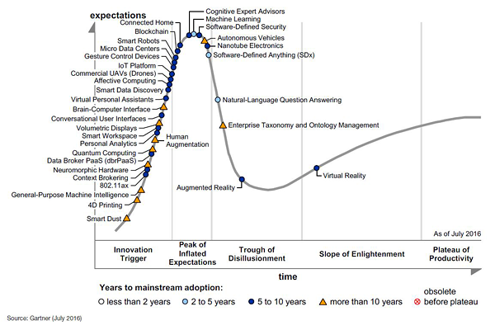
Gartner Hype Cycle 2016

Slide 10

Gartner Hype Cycle 2017

Slide 11
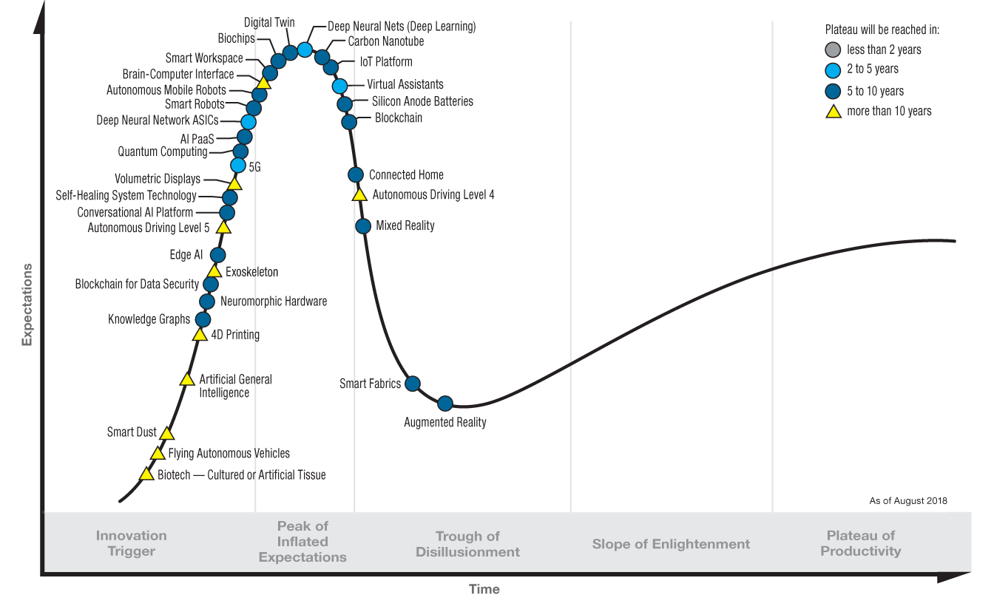
Gartner Hype Cycle 2018

Slide 12
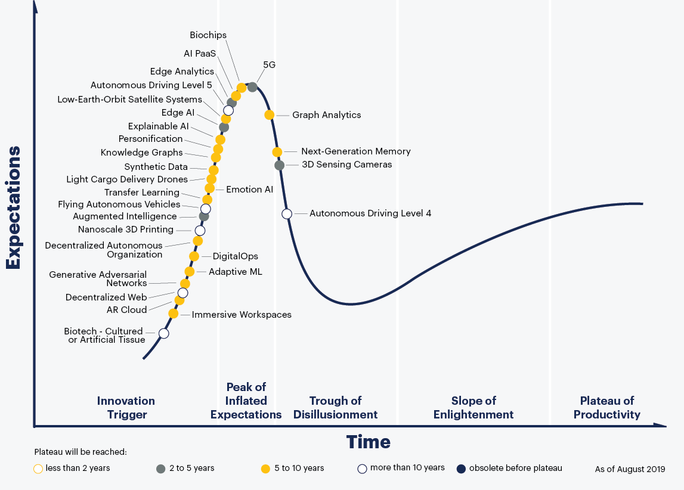

Slide 13
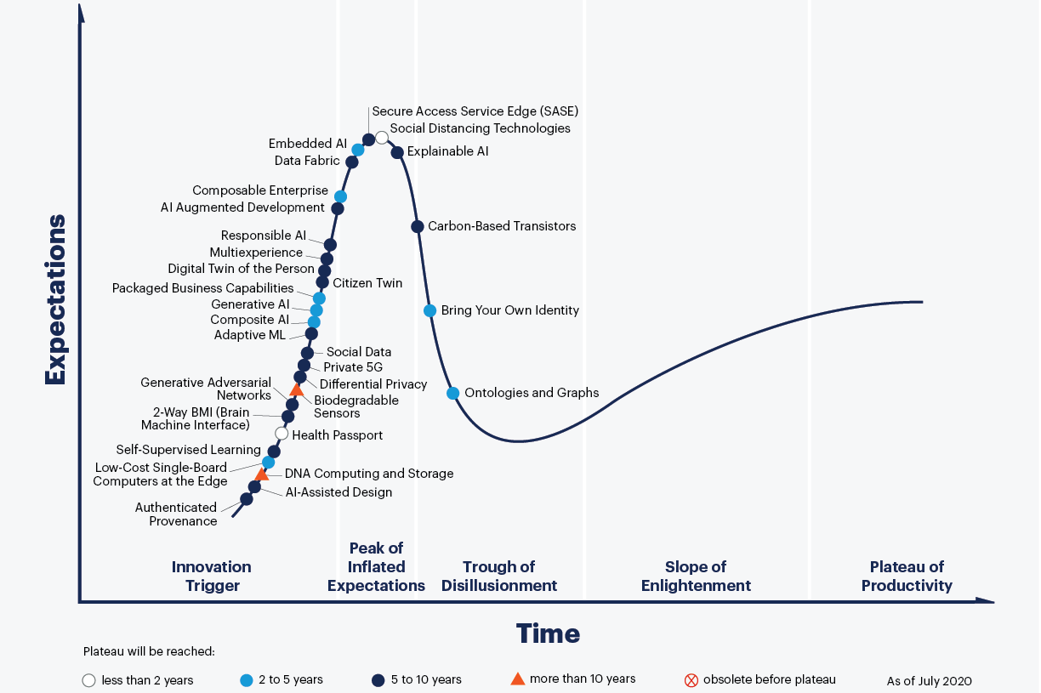

Slide 14
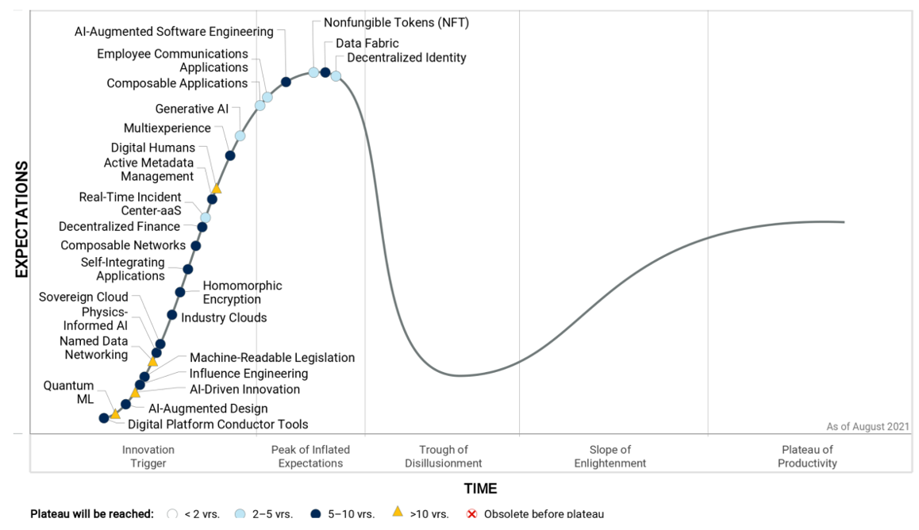
Gartner Hype Cycle 2021

Slide 15
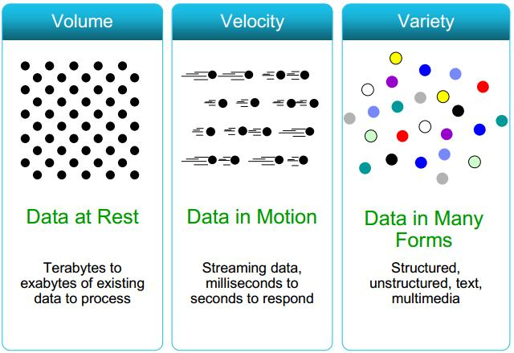
3 V’s of Big Data

Slide 16
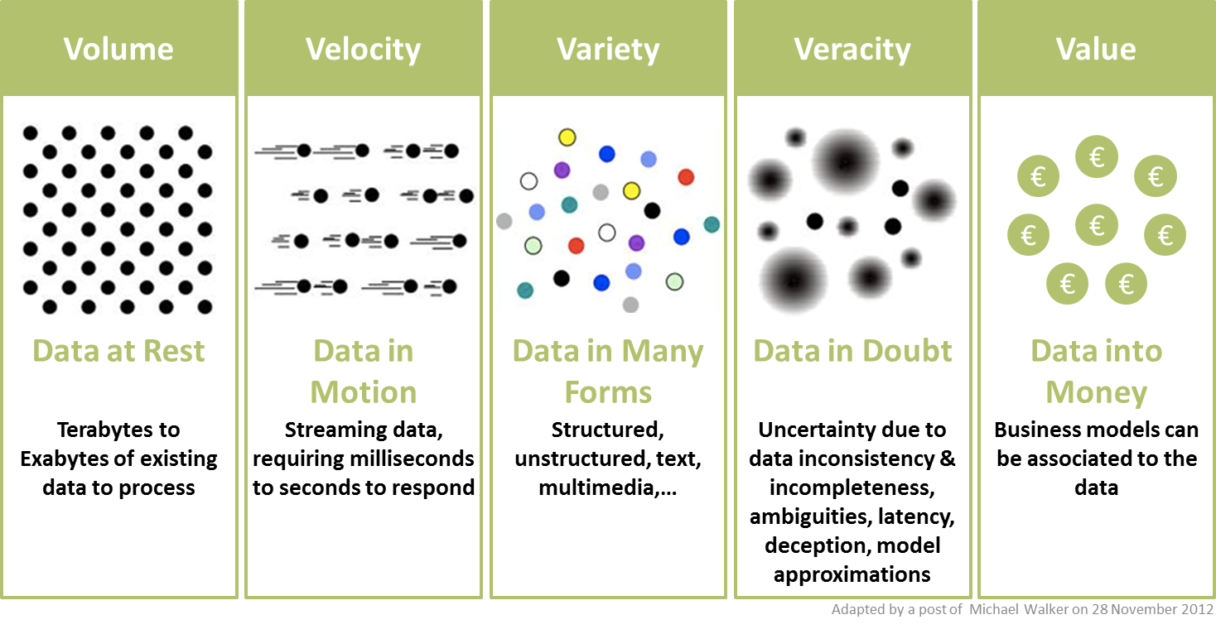
5 V’s of Big Data

Slide 17
Another 5 ?
Volume
Velocity
Variety
Veracity
Value
Validity
Variability
Venue
Vocabulary
Vagueness
Ordering Pizza in the Future

Slide 18
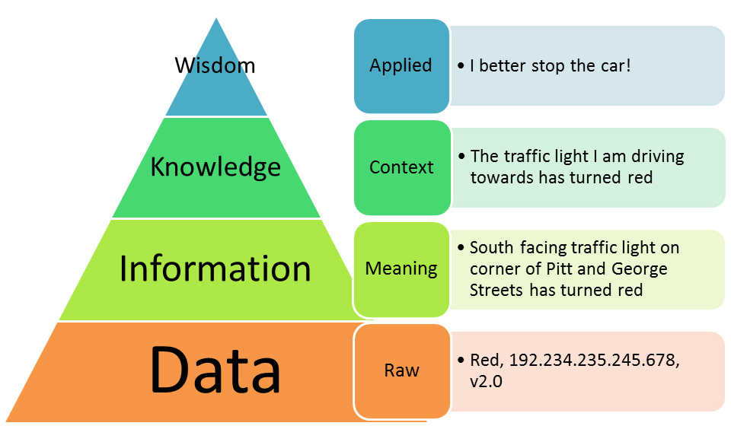
DIKW

Slide 19
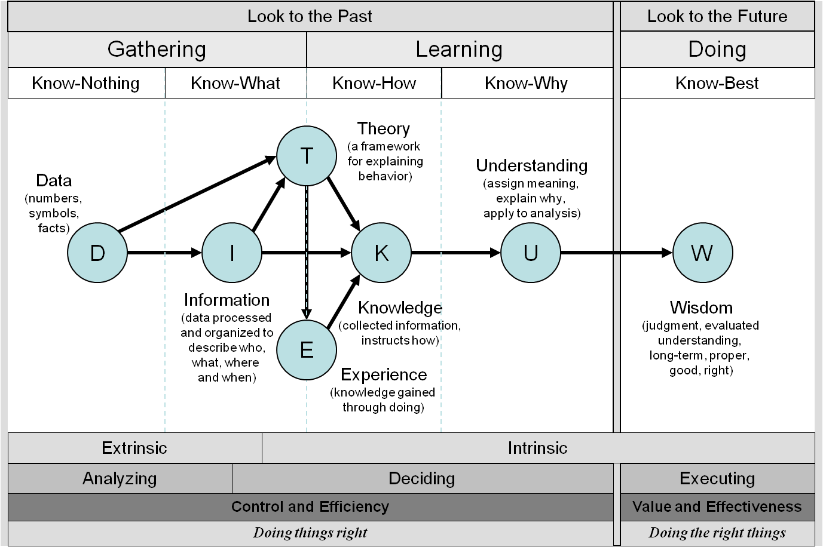
DIKUW

Slide 20
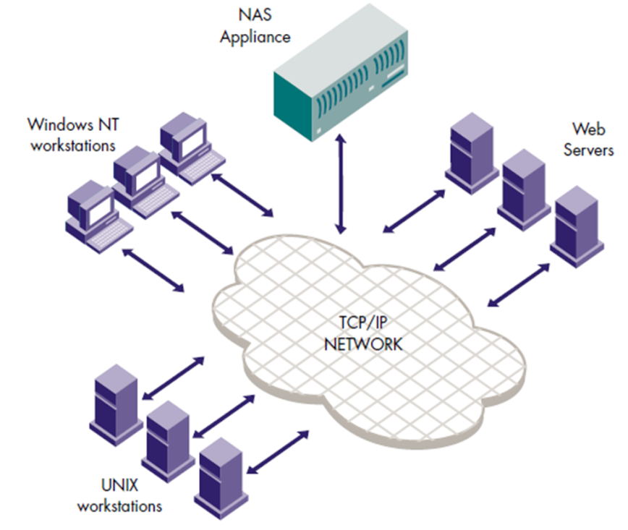
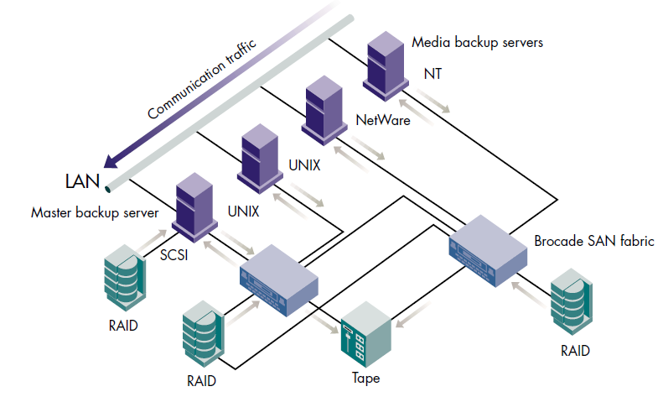
Motivation
Storage as NAS (Network Attached Storage) and SAN (Storage Area Network)
Data is moved to compute nodes at compute time

Slide 21
Motivation
Modern systems have to deal with huge data which has inherent value, and cannot be discarded
Getting the data to the processors becomes the bottleneck
The system must support partial failure
Adding load to the system should result in a graceful decline in performance

Slide 22
Motivation
Ability to scale out to Petabytes in size using commodity hardware
Processing (MapReduce) jobs are sent to the data versus shipping the data to be processed
Hadoop doesn’t impose a single data format so it can easily handle structure, semi-structure and unstructured data
Manages fault tolerance and data replication automatically

Slide 23
Core Principles
Scale-Out rather than Scale-Up
Bring code to data rather than data to code
Deal with failures – they are common
Abstract complexity of distributed and concurrent applications

Slide 24
Scale-Out rather than Scale-Up
It is harder and more expensive to Scale-Up
Add additional resources to an existing node (CPU, RAM)
Moore’s Law can’t keep up with data growth
New units must be purchased if required resources can not be added
Also known as scale vertically
Scale-Out
Add more nodes/machines to an existing distributed application
Software Layer is designed for node additions or removal
Hadoop takes this approach - A set of nodes are bonded together as a single distributed system
Very easy to scale down as well

Slide 25
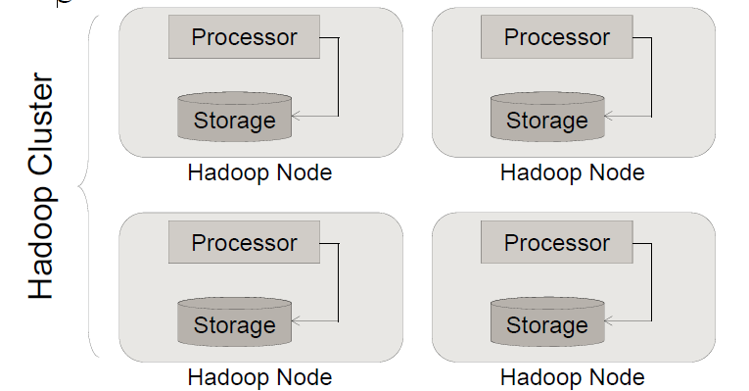
Bring Code to Data rather than Data to Code
Hadoop co-locates processors and storage
Code is moved to data (size is tiny, usually in KBs)
Processors execute code and access underlying local storage

Slide 26
Hadoop is designed to cope with node failures
If a node fails, the master will detect that failure and re-assign the work to a different node on the system
Restarting a task does not require communication with nodes working on other portions of the data
If a failed node restarts, it is automatically added back to the system and assigned new tasks
If a node appears to be running slowly, the master can redundantly execute another instance of the same task
Results from the first to finish will be used

Slide 27
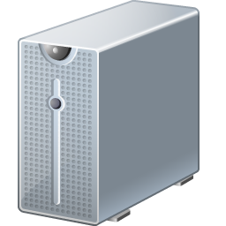
Hadoop Distributed File System
Block Size = 64MB
Replication Factor = 3
2
1
4
2
5
5
1
2
1
HDFS
3
3
4
4
5
2
5
1
3
Cost is $400-$500/TB
3
4
5
Notes:
Pool commodity servers in a single hierarchical namespace.
Designed for large files that are written once and read many times.
Example here shows what happens with a replication factor of 3, each data block is present in at least 3 separate data nodes.
Typical Hadoop node is eight cores with 16GB ram and four 1TB SATA disks.
Default block size is 64MB, though most folks now set it to 128MB

Slide 28
Abstract complexity
Hadoop abstracts many complexities in distributed and concurrent applications
Defines small number of components
Provides simple and well defined interfaces of interactions between these components
Frees developer from worrying about system level challenges
race conditions, data starvation
processing pipelines, data partitioning, code distribution
Allows developers to focus on application development and business logic

Slide 29
Hadoop Use Cases
Use Case
Application
Industry
Application
Use Case
Social Network Analysis
Web
Clickstream Sessionization
Content Optimization
Media
Clickstream Sessionization
Network Analytics
Telco
Mediation
ADVANCED ANALYTICS
Loyalty & Promotions Analysis
Retail
Data Factory
DATA PROCESSING
Fraud Analysis
Financial
Trade Reconciliation
Entity Analysis
Federal
SIGINT
Sequencing Analysis
Bioinformatics
Genome Mapping

Slide 30
Three papers by Google
Google File System
MapReduce
BigTable

Slide 31
Apache Hadoop
Open source (using the Apache license)
Around 40 core Hadoop committers from companies like
Yahoo!, Facebook, Apple, Cloudera, and more
Hundreds of contributors writing features, fixing bugs and other ecosystem products

Slide 32
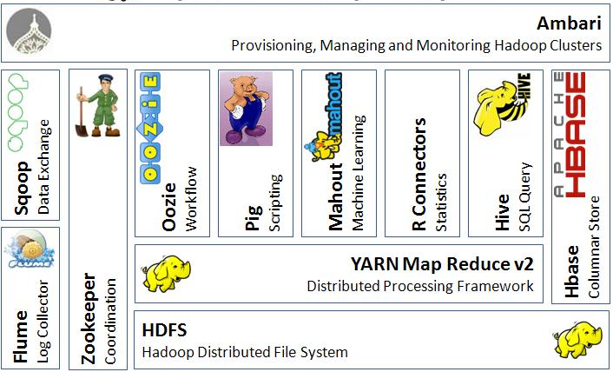
Hadoop Ecosystem

Slide 33
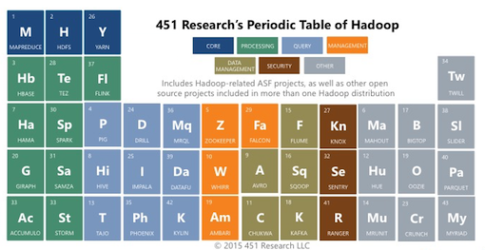
Research Periodic Table

Slide 34
Hadoop Ecosystem
Hadoop Distributed File System (HDFS): A distributed file system that provides high-throughput access to application data.
Hadoop MapReduce: A distributed parallel data processing model and execution environment for handling large data sets.
Hadoop YARN: A framework for job scheduling and cluster resource management.
HBase: A scalable, distributed column oriented database that supports structured data storage for large tables.

Slide 35
Hadoop Ecosystem
Pig: A high-level data-flow language and execution framework for parallel computation of large datasets
Hive: A distributed data warehouse query language based on SQL that provides data summarization and ad hoc querying.
Cassandra: A scalable multi-master database with no single points of failure.
Mahout: A Scalable machine learning and data mining library.
Chukwa: A data collection system for managing large distributed systems.

Slide 36
Hadoop Ecosystem
Flume: A distributed, reliable, available service for efficiently moving large amounts of data as it is produced
Sqoop: A tool for efficiently moving data between relational databases and HDFS (SQL to Hadoop)
Oozie: A tool to provide way for developers to define an entire workflow
Hue: Graphical front-end to developer and administrator functionality
ZooKeeper: A distributed, highly available coordination service.

Slide 37
Hadoop Ecosystem
Avro: A data serialization system.
Spark: A fast and general compute engine for Hadoop data supporting machine learning, stream processing, and graph computation
Ambari: A web-based tool for provisioning, managing, and monitoring Apache Hadoop clusters which includes support for HDFS, MapReduce, Hive, HBase, ZooKeeper, Oozie, Pig and Sqoop.
Hadoop Ecosystem Table on GitHub

Slide 38
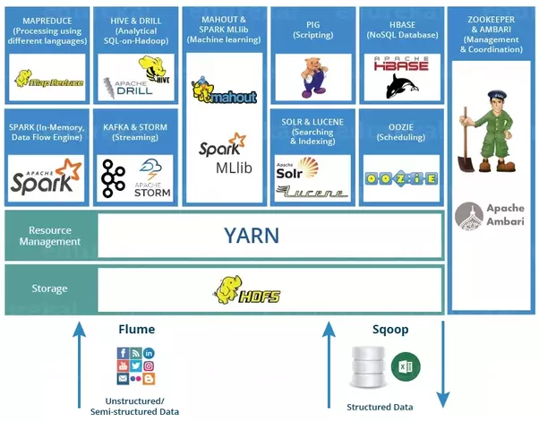
Hadoop Ecosystem

Slide 39
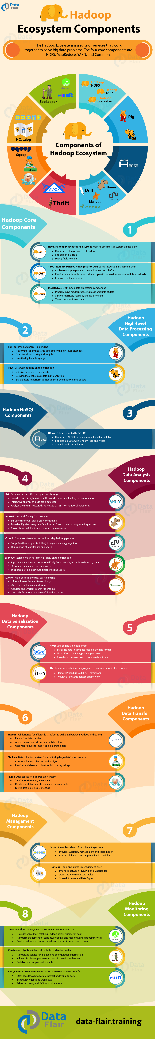
Hadoop Eco System

Slide 40
Hadoop Core Components

Slide 41
High Level Data Processing

Slide 42
NoSQL

Slide 43
Data Analytic Components

Slide 44
Data Analytic Components

Slide 45
Data Serialization Components

Slide 46
Data Transfer Components

Slide 47
Management Components

Slide 48
Monitoring Components

Slide 49
Benefit of Agility / Flexibility
Schema-on-Write (RDBMS)
Schema-on-Read (Hadoop)
Schema must be created before any data can be loaded.
An explicit load operation has to take place which transforms data to DB internal structure.
New columns must be added explicitly before new data for such columns can be loaded into the database.
Read is Fast
Standards / Governance
Data is simply copied to the file store, no transformation is needed.
A SerDe (Serializer / Deserlizer) is applied during read time to extract the required columns (late binding)
New data can start flowing anytime and will appear retroactively once the SerDe is updated to parse it.
Load is Fast
Flexibility / Agility

Slide 50
Original Raw Data

Slide 51
Scalable: Grows without changes

Slide 52
Data beats Algorithms

Slide 53
Keep All Data Alive Forever

Slide 54
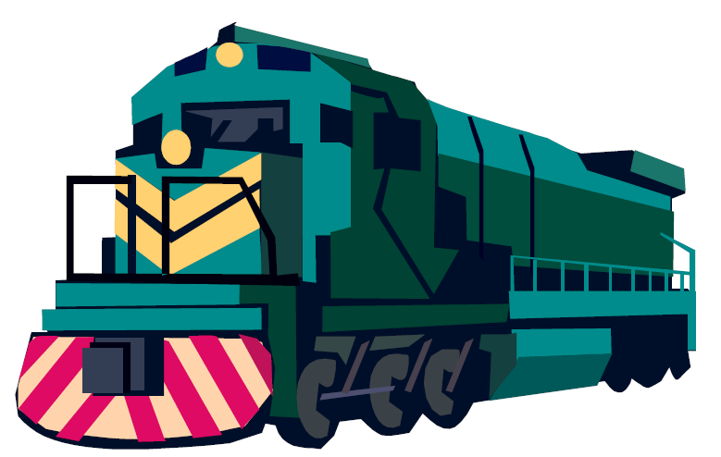
Right Tool for the Right Job
Relational Databases
Hadoop
Use when:
Interactive OLAP Analytics (<1sec)
Multistep ACID Transactions
100% SQL Compliance
Use when:
Structured or Not (Flexibility)
Scalability of Storage/Compute
Complex Data Processing

Slide 55
Hadoop HDFS
Hadoop Distributed File System is responsible for storing data on the cluster
Data files are split into blocks and distributed across multiple nodes in the cluster
Each block is replicated multiple times
Default is to replicate each block three times
Replicas are stored on different nodes
This ensures both reliability and availability

Slide 56
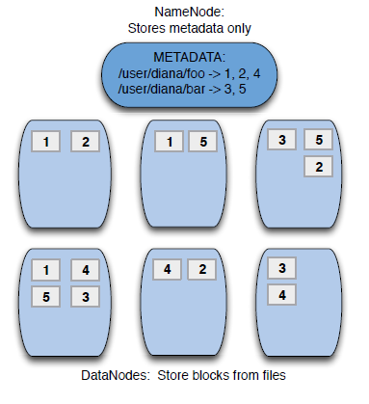
Hadoop HDFS

Slide 57
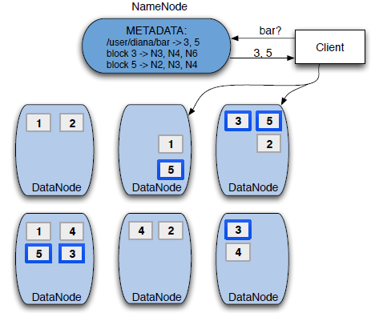
Hadoop HDFS

Slide 58
Hadoop Daemons
Hadoop is comprised of five separate daemons
NameNode: Holds the metadata for HDFS
Secondary NameNode
Performs housekeeping functions for the NameNode
Is not a backup or hot standby for the NameNode!
DataNode: Stores actual HDFS data blocks
JobTracker: Manages MapReduce jobs, distributes individual tasks
TaskTracker: Responsible for instantiating and monitoring individual Map and Reduce tasks

Slide 59


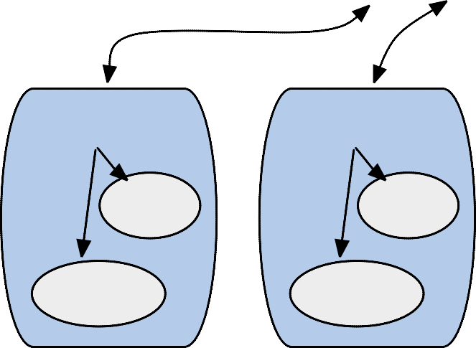
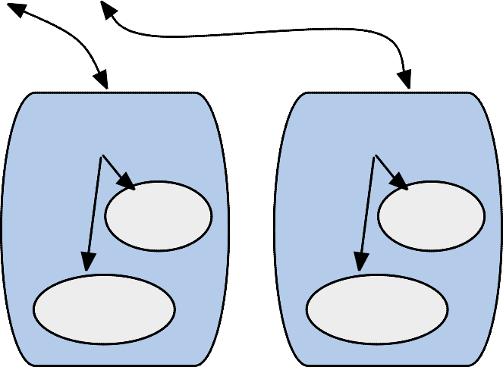

Five Hadoop Daemons
Client
[ sends .jar and .xml ]
NameNode
Master Node
[ file location info ]
JobTracker
[ determines execution plan ]
TaskTracker
TaskTracker
TaskTracker
TaskTracker
Map
Map
Map
Map
Reduce
Reduce
Reduce
Reduce
DataNode
DataNode DataNode [ reads and writes HDFS files ]
DataNode
Slave Nodes

Slide 60
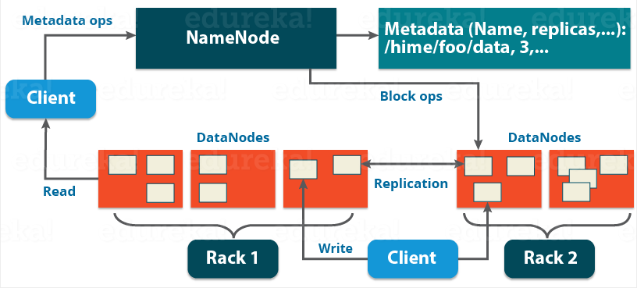
HDFS Architecture

Slide 61
Functions of Name Node
It is the master daemon that maintains and manages the DataNodes (slave nodes)
It records the metadata of all the files stored in the cluster, e.g. The location of blocks stored, the size of the files, permissions, hierarchy, etc. There are two files associated with the metadata:
FsImage: Complete state of the file system namespace since the start of the NameNode.
EditLogs: All the recent modifications made to the file system with respect to the most recent FsImage.
It records each change that takes place to the file system metadata.

Slide 62
Functions of Name Node
It regularly receives a Heartbeat and a block report from all the DataNodes in the cluster to ensure that the DataNodes are live.
It keeps a record of all the blocks in HDFS and in which nodes these blocks are located.
The NameNode is also responsible to take care of the replication factor .
In case of the DataNode failure, the NameNode chooses new DataNodes for new replicas, balance disk usage and manages the communication traffic to the DataNodes.

Slide 63
Functions of Data Node
These are slave daemons or process which runs on each slave machine.
The actual data is stored on DataNodes.
The DataNodes perform the low-level read and write requests from the file system’s clients.
They send heartbeats to the NameNode periodically to report the overall health of HDFS, by default, this frequency is set to 3 seconds.

Slide 64
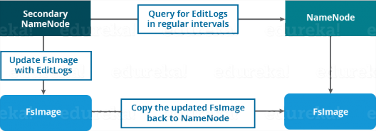
Secondary Name Node

Slide 65
Secondary Name Node
The Secondary NameNode is one which constantly reads all the file systems and metadata from the RAM of the NameNode and writes it into the hard disk or the file system.
It is responsible for combining the EditLogs with FsImage from the NameNode.
It downloads the EditLogs from the NameNode at regular intervals and applies to FsImage.
The new FsImage is copied back to the NameNode, which is used whenever the NameNode is started the next time

Slide 66
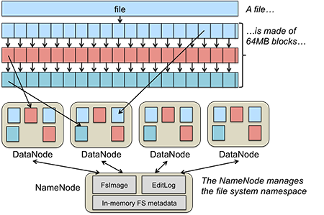
Blocks Replication

Slide 67
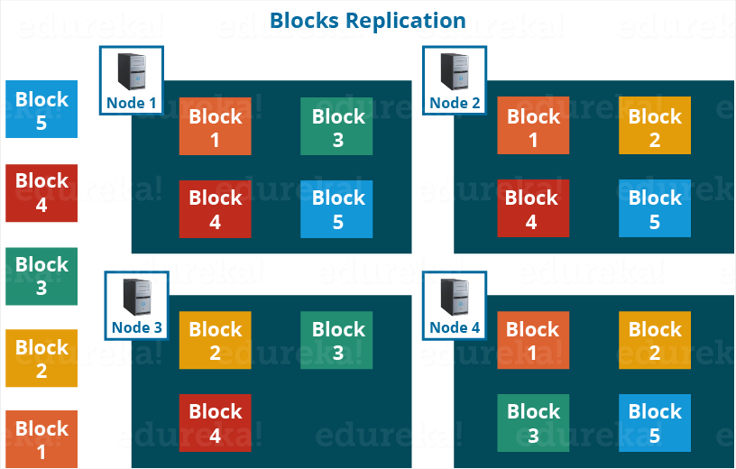
Blocks Replication

Slide 68
HDFS File Read

Slide 69
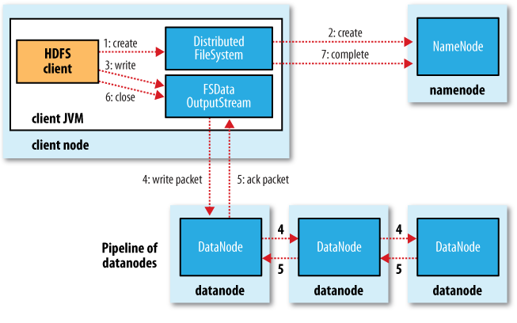
HDFS File Write

Slide 70
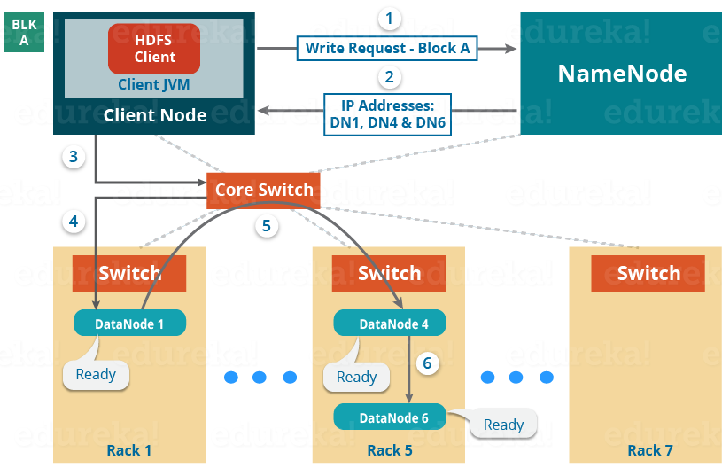
Setting up HDFS Pipeline

Slide 71
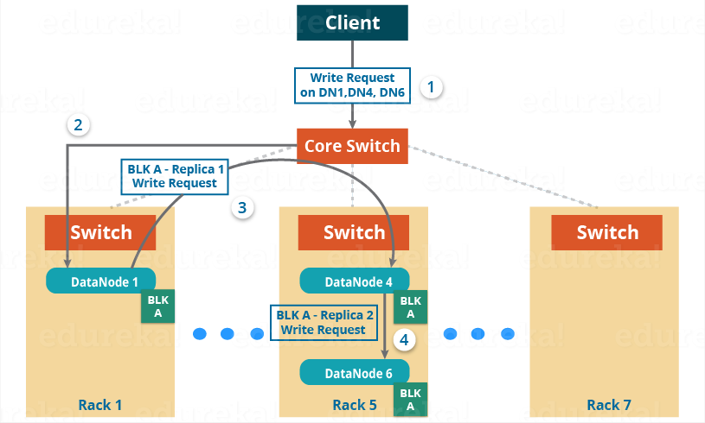
HDFS Write Pipeline

Slide 72
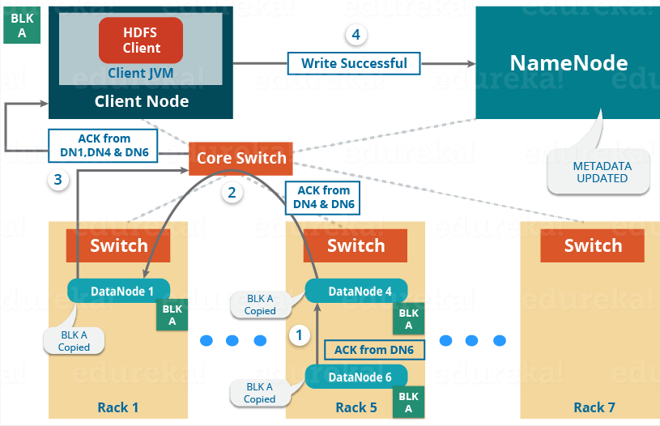
Acknowledgement HDFS Write

Slide 73
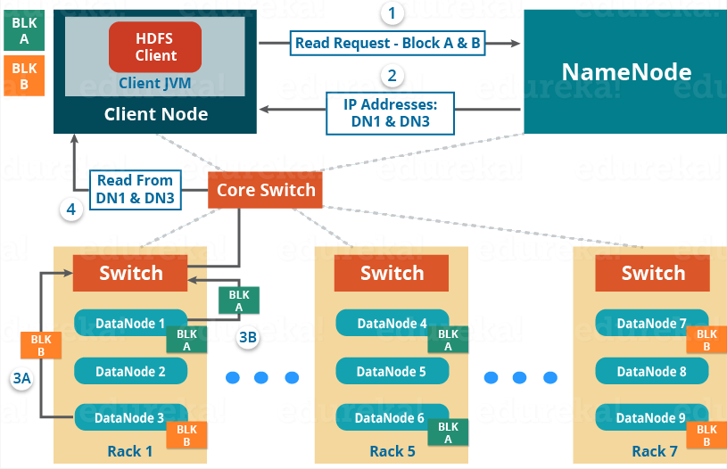
HDFS Read

Slide 74
Hadoop MapReduce
MapReduce is the system used to process data in the Hadoop cluster
Consists of two phases: Map, and then Reduce
Each Map task operates on a discrete portion (one HDFS Block) of the overall dataset
MapReduce system distributes the intermediate data to nodes which perform the Reduce phase

Slide 75
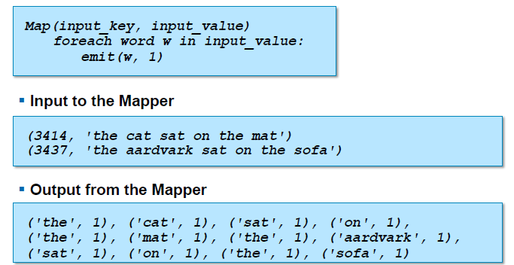
Hadoop MapReduce

Slide 76
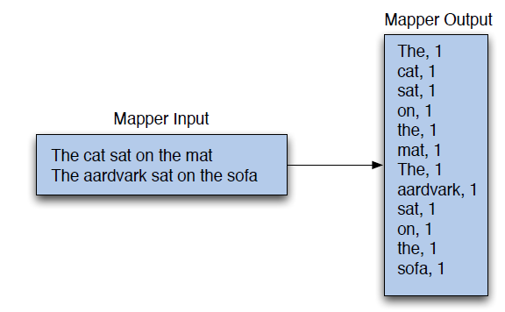
Hadoop MapReduce

Slide 77
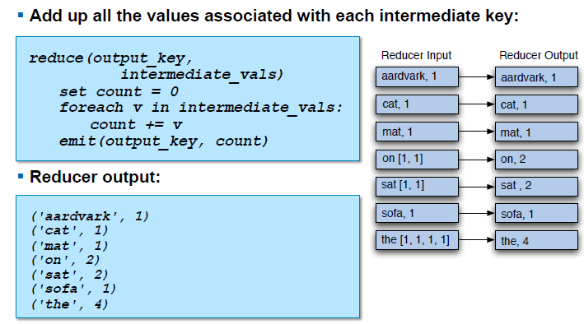
Hadoop MapReduce

Slide 78
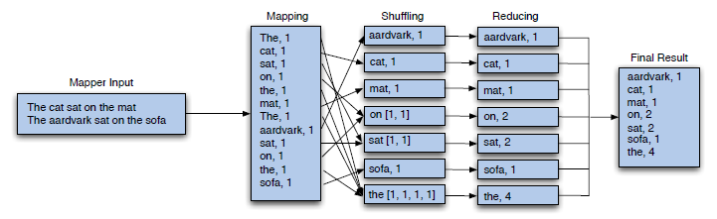
Hadoop MapReduce

Slide 79
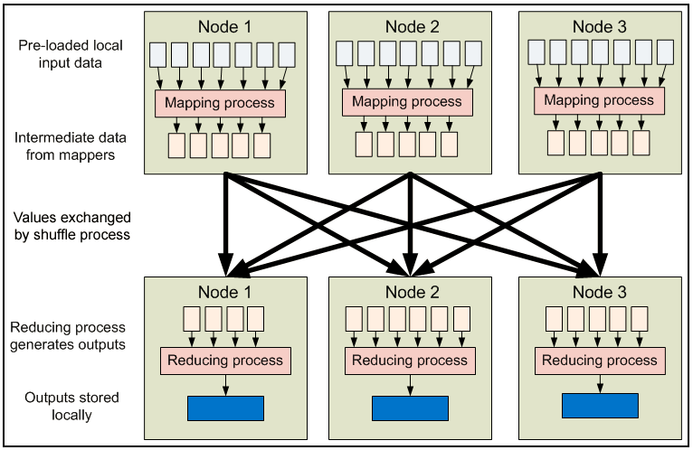
Hadoop MapReduce

Slide 80
Hadoop MapReduce

Slide 81

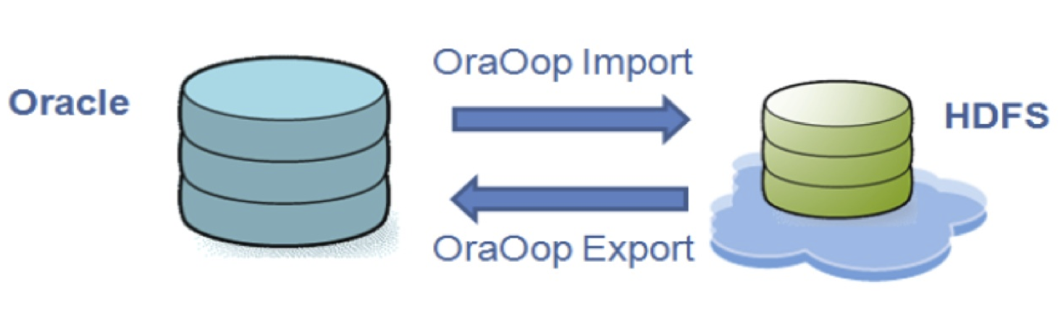
Sqoop
SQL to Hadoop
Tool to import/export any JDBC-supported database into Hadoop
Transfer data between Hadoop and external databases or EDW
High performance connectors for some RDBMS
Developed at Cloudera

Slide 82

Flume
Distributed, reliable, available service for efficiently moving large amounts of data as it is produced
Suited for gathering logs from multiple systems
Inserting them into HDFS as they are generated
Design goals
Reliability, Scalability, Manageability, Extensibility
Developed at Cloudera

Slide 83



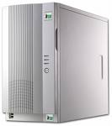

Flume Architecture
Master send configuration to all Agents
Configurable levels of reliability
Guarantee delivery in event of failure
Deployable, centrally administered
Agent
Agent
Agent
Agent
encrypt
MASTER
Optionally pre-process incoming data: perform transformations, suppressions, metadata enrichment
Processor
Processor
compress
batch
encrypt
Writes to multiple HDFS file formats (text, sequence, JSON, Avro, others)
Parallelized writes across many collectors – as much write throughput as
Collector(s)
Flexibly deploy decorators at any step to improve performance, reliability or security

Slide 84

HBase
Column-family store. Based on design of Google BigTable
Provides interactive access to information
Holds extremely large datasets (multi-TB)
Constrained access model
(key, value) lookup
Limited transactions (only one row)

Slide 85
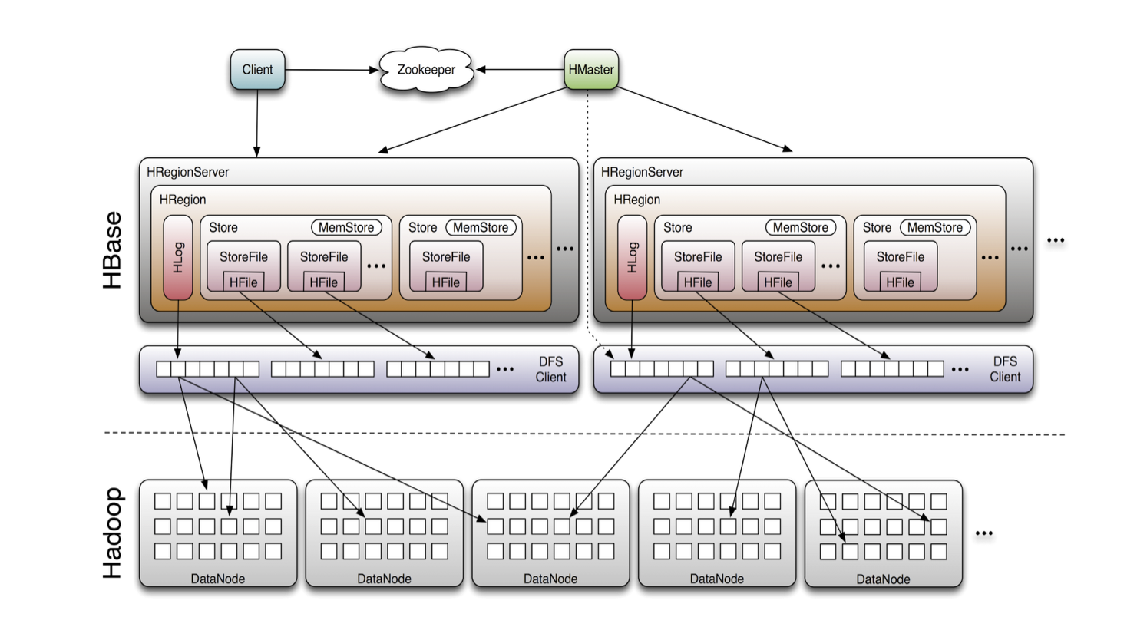
HBase Architecture

Slide 86

Hive
SQL-based data warehousing application
Language is SQL-like
Supports SELECT, JOIN, GROUP BY, etc.
Features for analyzing very large data sets
Partition columns, Sampling, Buckets
Example:
SELECT s.word, s.freq, k.freq FROM shakespeares
JOIN ON (s.word= k.word) WHERE s.freq >= 5;

Slide 87

Pig
Data-flow oriented language – “Pig latin”
Datatypes include sets, associative arrays, tuples
High-level language for routing data, allows easy integration of Java for complex tasks
Example:
emps=LOAD 'people.txt’ AS(id,name,salary);
rich = FILTER emps BY salary > 100000; srtd = ORDER rich BY salary DESC; STORE srtd INTO ’ rich_people.txt';

Slide 88

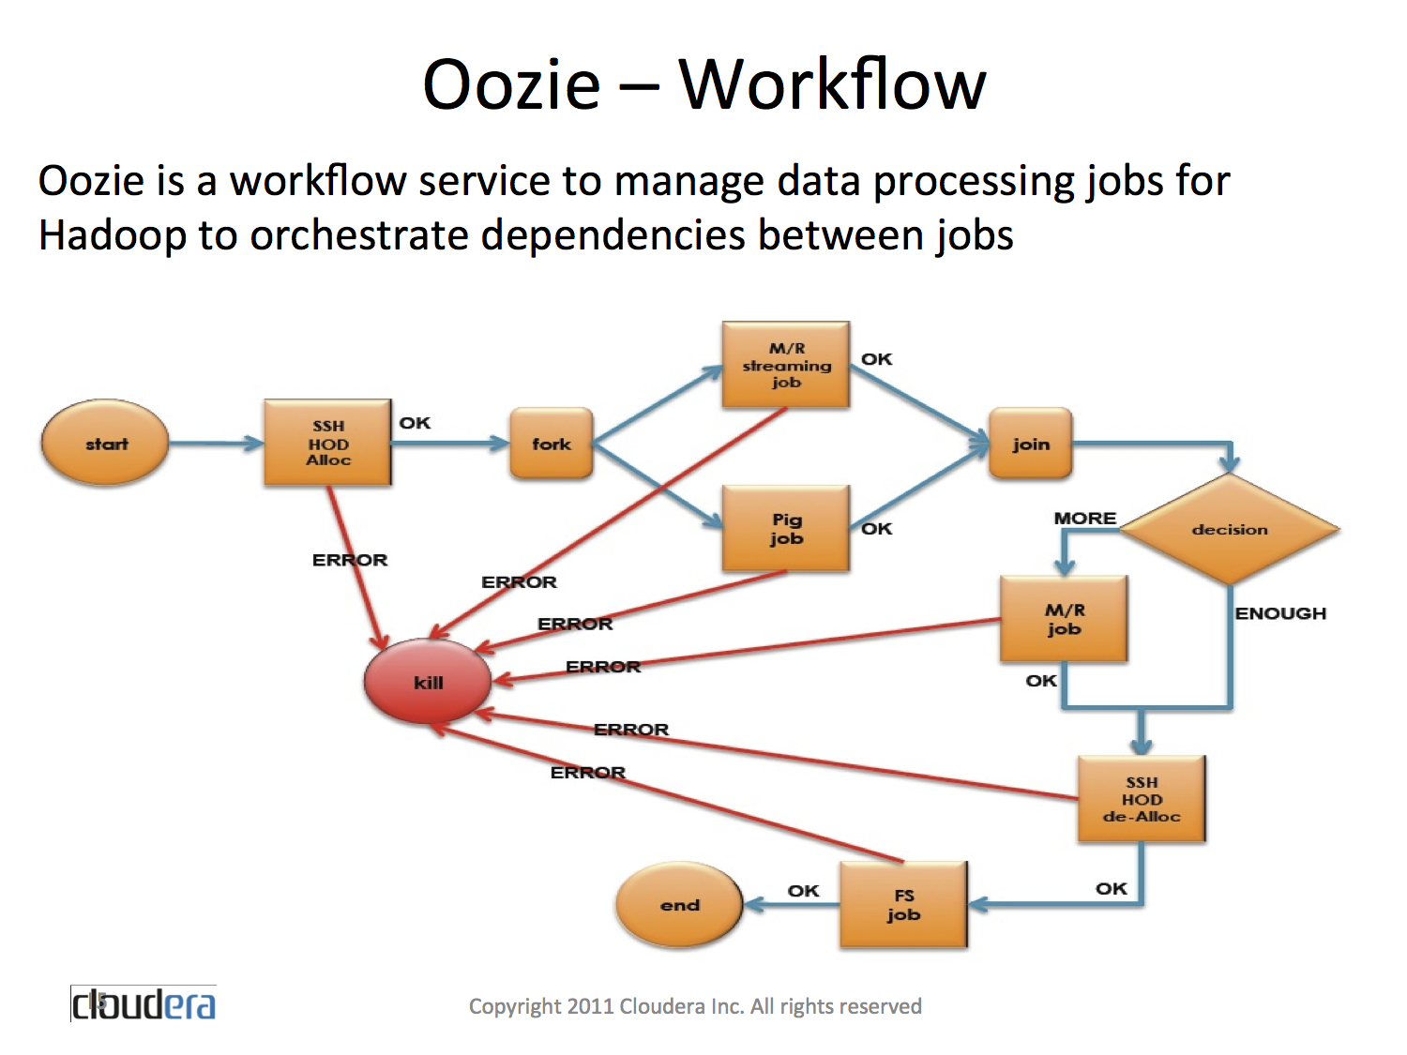
Oozie
Oozie is a workflow/cordination service to manage data processing jobs for Hadoop

Slide 89

Zookeeper
Zookeeper is a distributed consensus engine
Provides well-defined concurrent access semantics:
Leader election
Service discovery
Distributed locking / mutual exclusion
Message board / mailboxes

Slide 90


Any Questions
and Thanks

